Slide 1
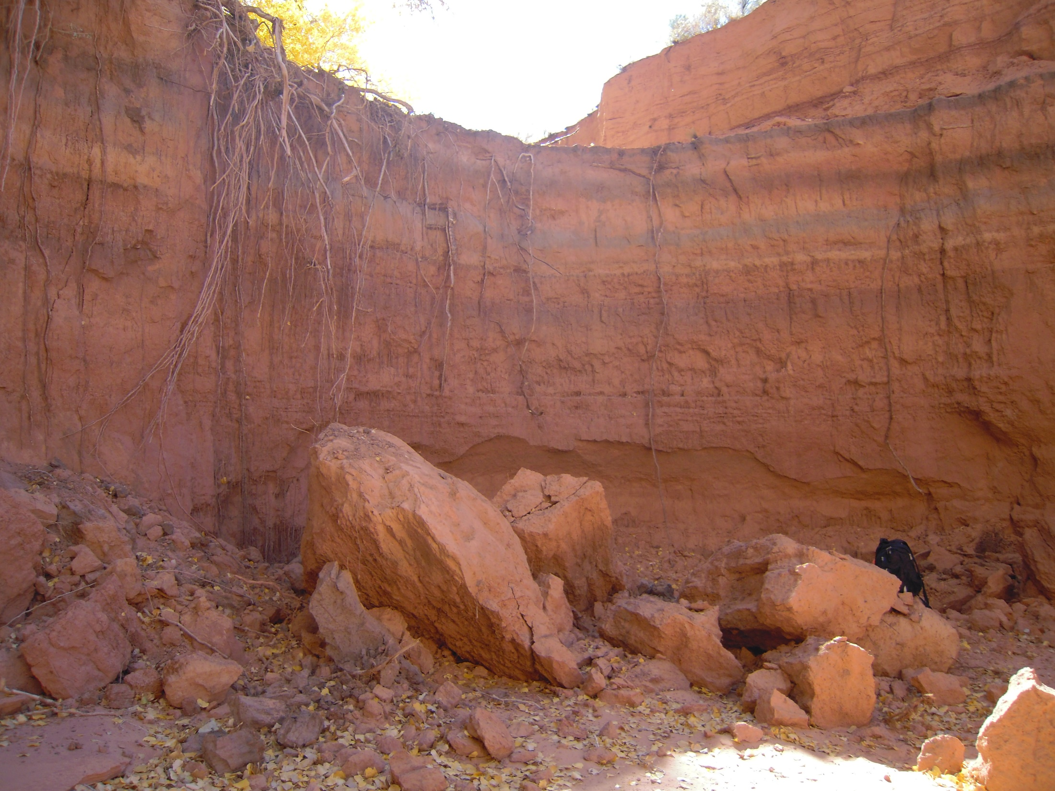
Tsegi Wash
Dan Larson, Leticia Delgado, Jessica Carnes
Final Capstone Presentation

Slide 2
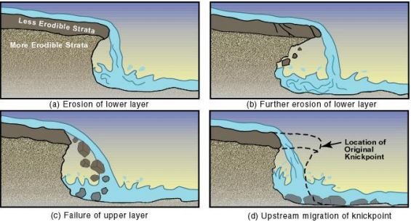
Problem Statement
The purpose of this project is to determine the feasibility of a stabilization method to minimize soil erosion and stream scour of a channel headcut.
Source: http://www.iowadot.gov/research/reports/Year/2008/fullreports/TR-541%20Final%20-%20T.%20Papanicolaou.pdf

Slide 3
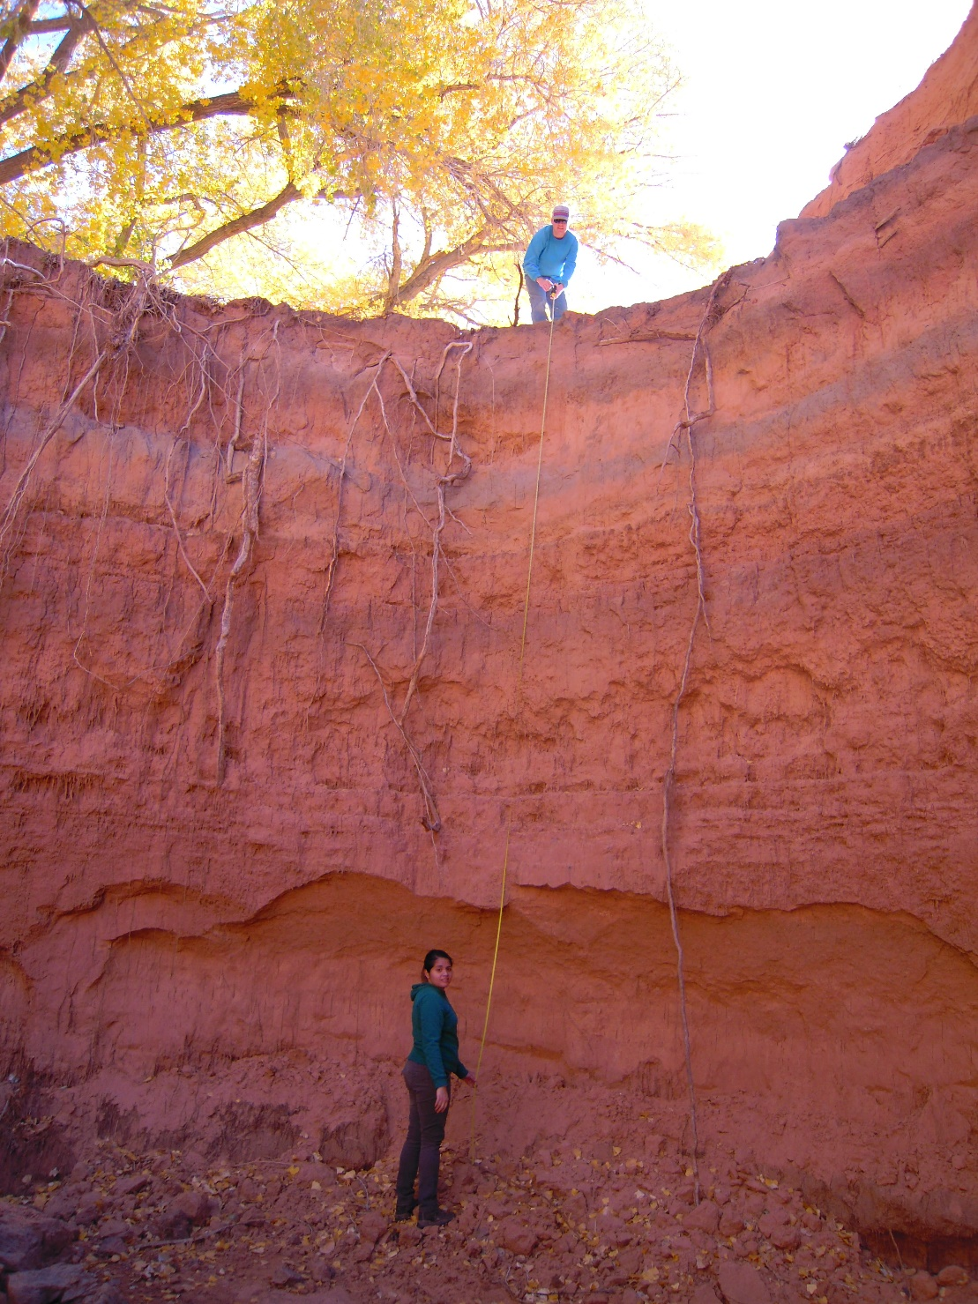


Slide 4
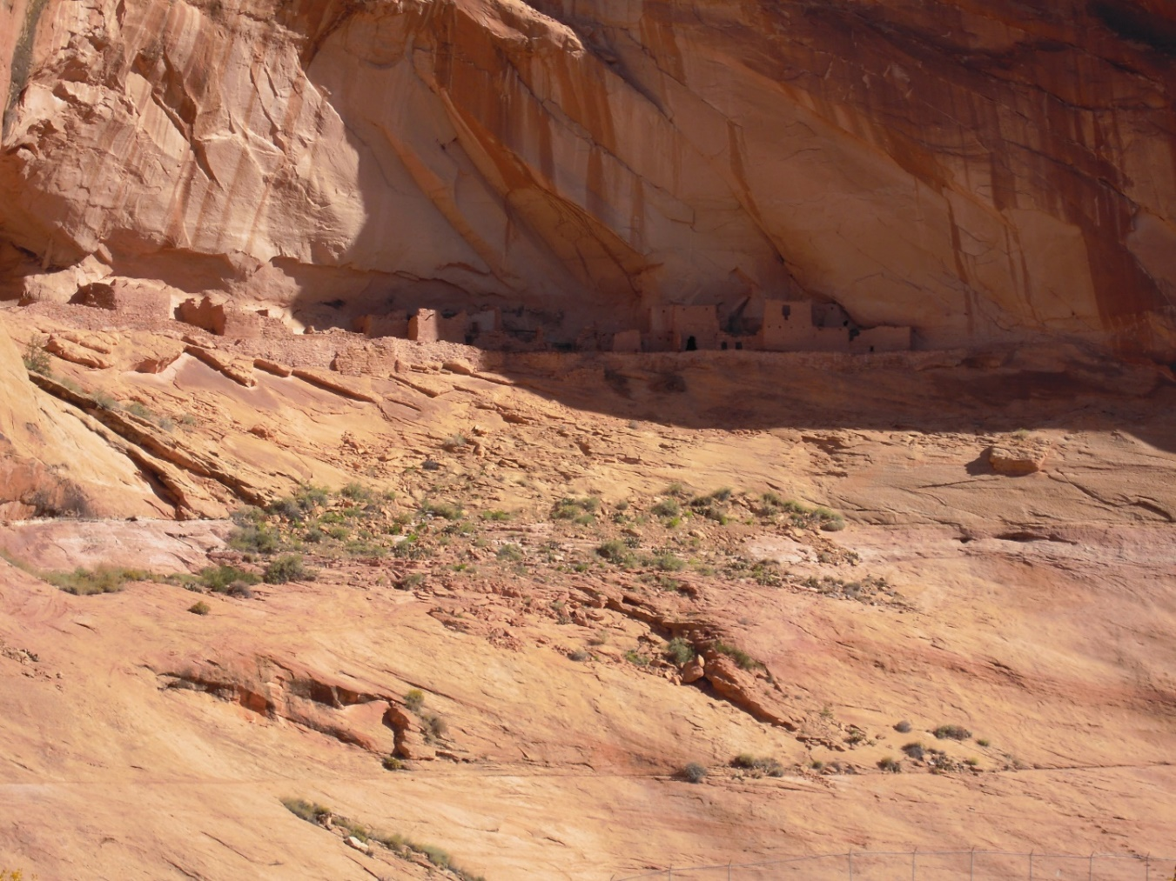
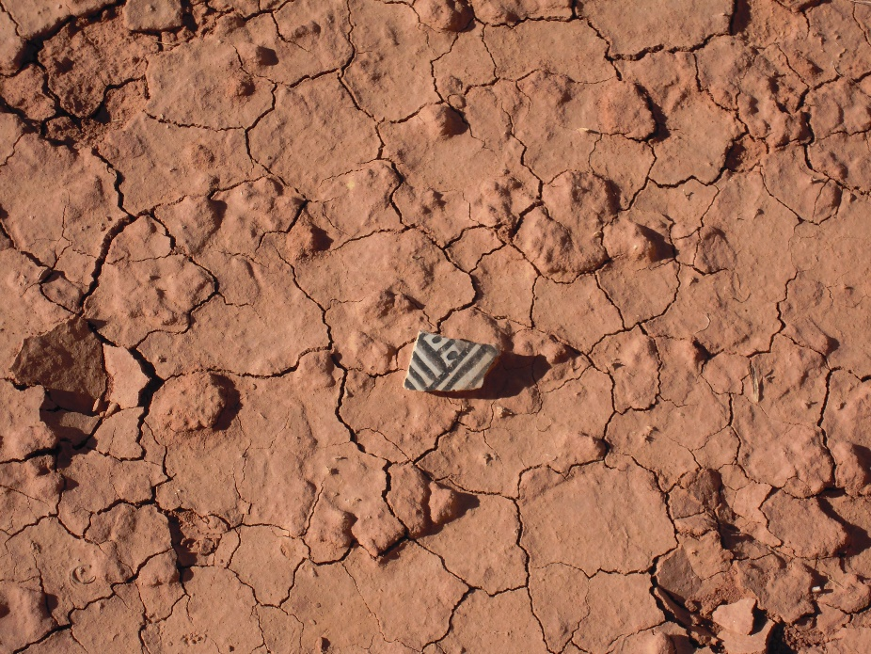
Introduction & Background
  Inscription House closed to public since 1968
  30-40 years ago headcuts began spreading along canyon
  Canyon drains into Lake Powell
  Land user’s cattle grazing is causing erosion

Slide 5
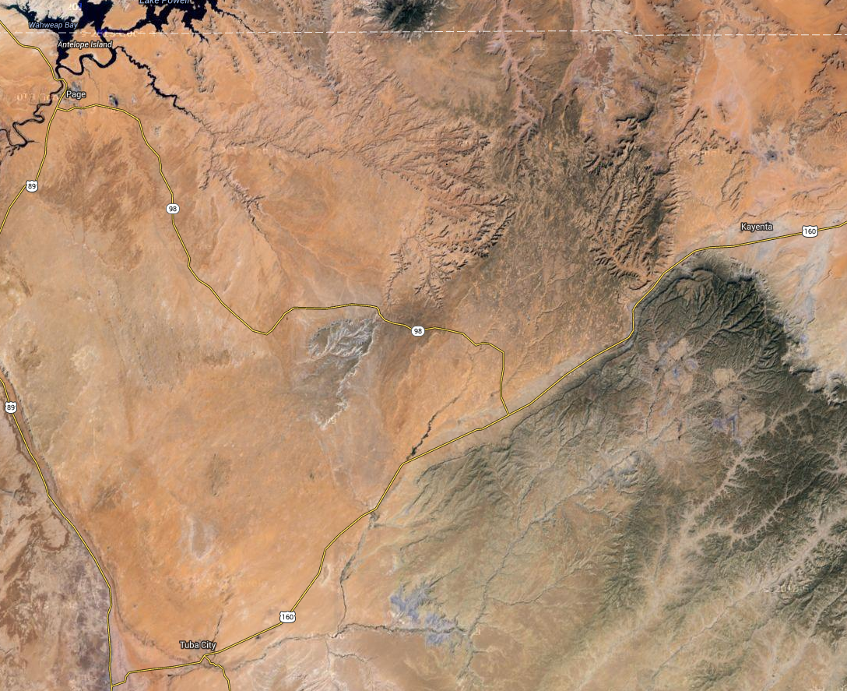
N
Lake Powell
Location of Project Site:
Aerial View of Nitsin Canyon and Surrounding Area
137 miles N of Flagstaff, AZ
Source: Google Maps

Slide 6
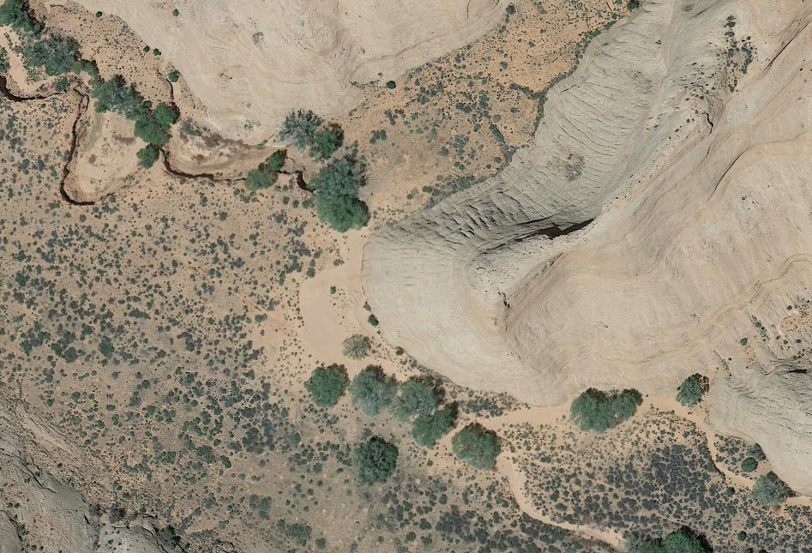
Project Site Location: Aerial View of Headcut
N
Source: Google Maps

Slide 7
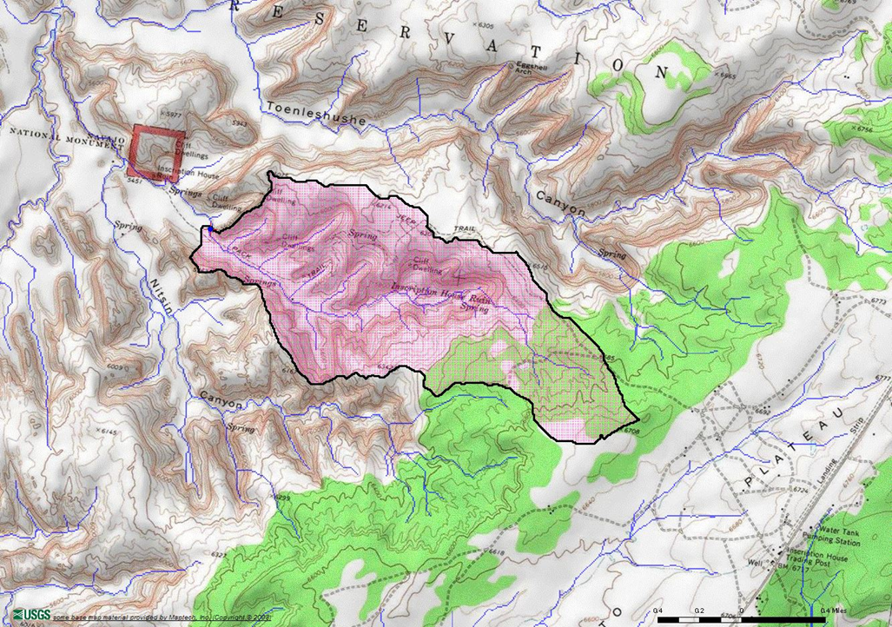
Watershed Delineation
Navajo National Monument
Point Source - Headcut
N
Area that flows towards the headcut
Area - 1.32 square miles
Basin Elevation - 6080 ft.
Source: United States Geological Survey StreamStats

Slide 8
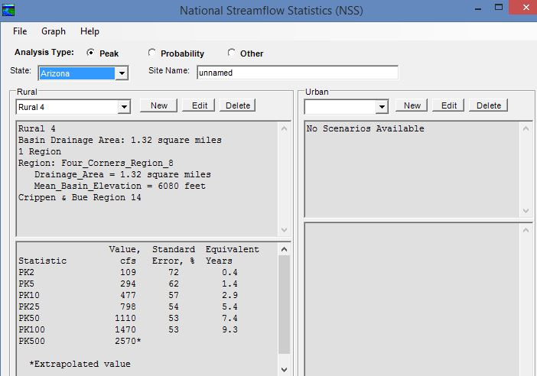
National Streamflow Statistics (NSS)
Design Flood Flows
10 year flow – 477 cfs
25 year flow – 798 cfs
100 year flow – 1470 cfs
Source: NSS Software

Slide 9
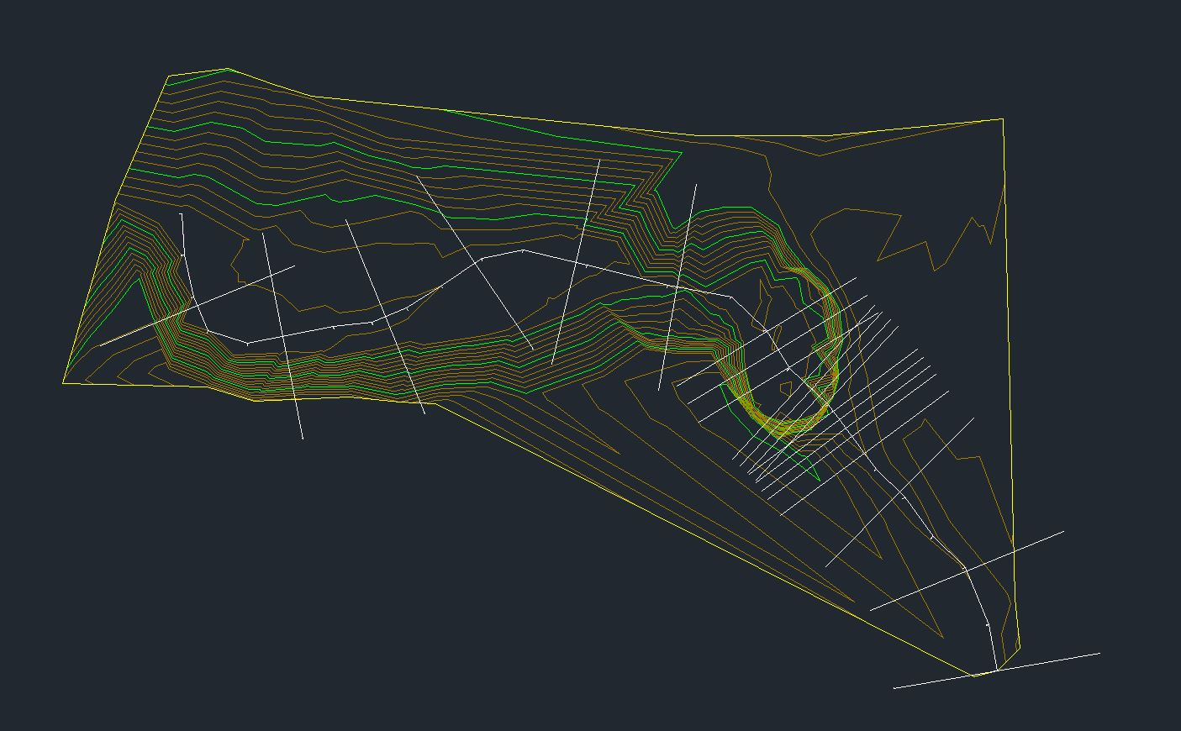
Survey Data
N
Source: AutoCAD Civil 3D

Slide 10
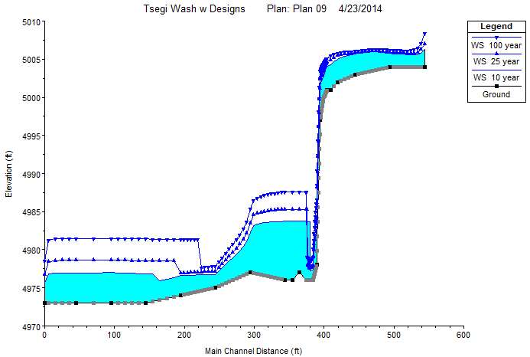

HEC-RAS: Current Conditions

Slide 11
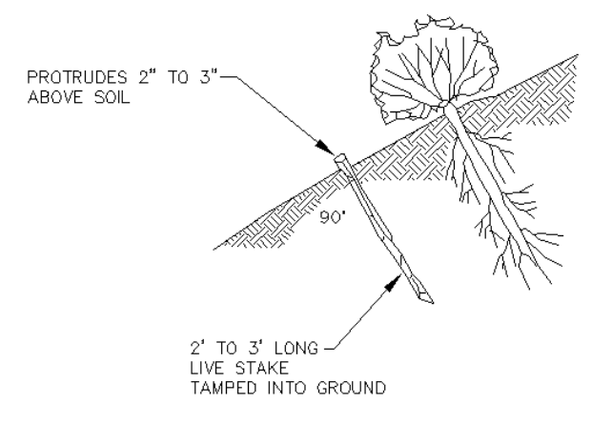
Live Vegetation
The process of planting suitable vegetation along the shorelines of channel to prevent erosion.
10:1 Slope
Grass Seed Mixture
Willow Stakes
  1 -3 in. in diameter
  Placed 1-3 ft. apart
Source: http://www.epa.gov/owow/nps/unpavedroads/ch5.pdf

Slide 12
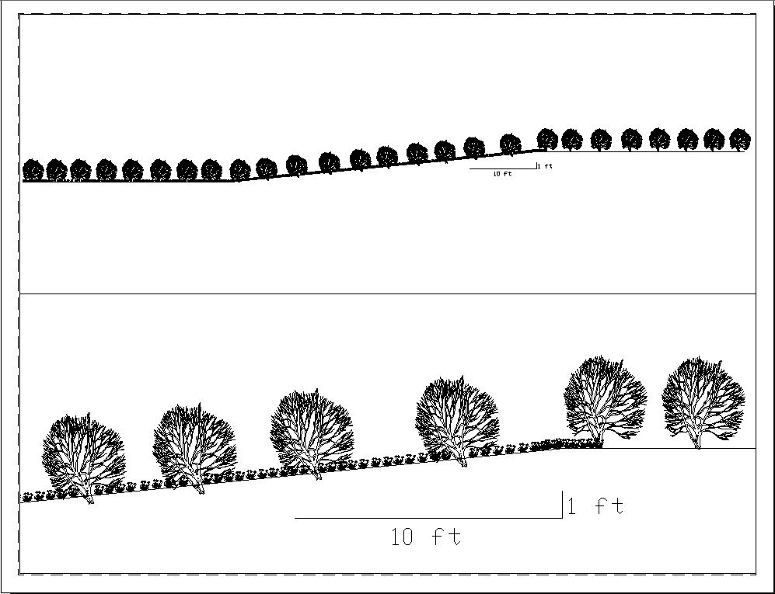
Manning’s Coefficients:
Upstream – 0.15, all willows
Headcut – 0.9, 50% willows 50% grass
Slope & Downstream – 0.078, 40% willows 60% grass
See Detail Below
Source: AutoCAD Civil 3D

Slide 13
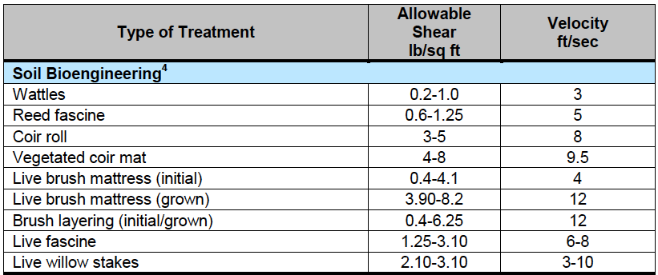
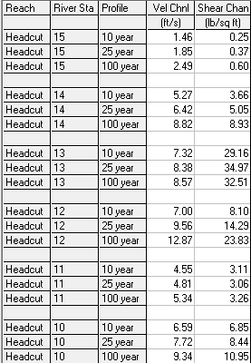
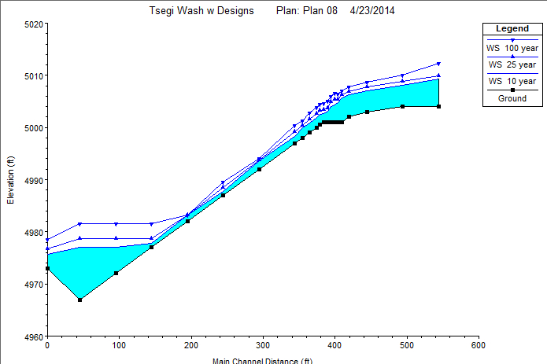
Source: Natural Resources Conservation Service (NRCS)
Source: HEC-RAS Software

Slide 14
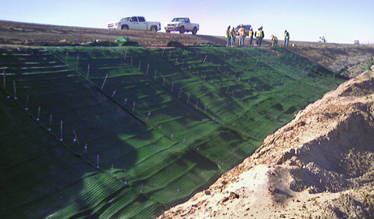
Bioengineering
The combined use of live vegetation with structural materials to provide stream bank stabilization and erosion control.
5:1 Slope
Turf Reinforcement Mat
  Combination of vegetative growth and synthetic materials
Grass Seeding
Willow Stakes
Boulders
Source: http://www.conteches.com/products/erosion-control/temporary-and-permanent/turf-reinforcement-mats.aspx

Slide 15
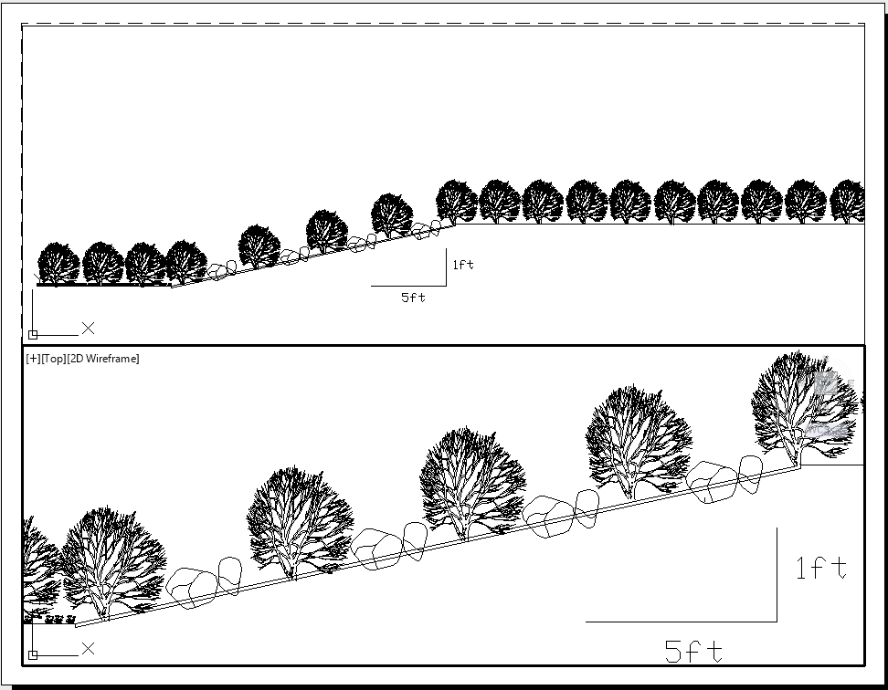
Manning’s Coefficients:
Upstream – 0.15, all willows
Slope – 0.11, 50% willows 50% boulders
Downstream – 0.09, 50% willows 50% grass
See Detail Below
Source: AutoCAD Civil 3D

Slide 16
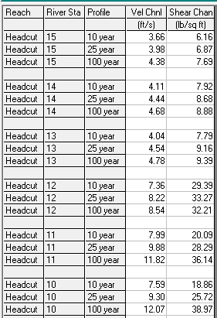
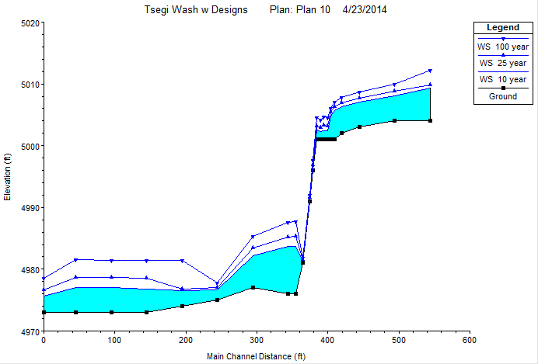
Source: NRCS
Source: Erosion Control Technology Council
Max Shear Stress for a Turf Reinforcement Mat - 10 lbs/sqft.
Source: HEC-RAS Software

Slide 17
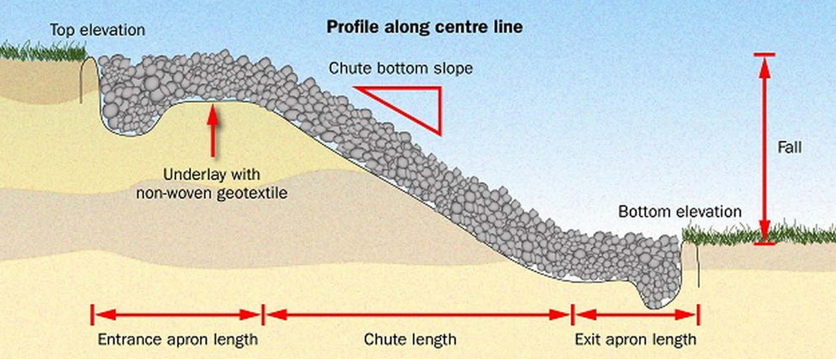
Hard Armoring
The technical placement of various sized rocks along a channel slope or streamline, reducing the flow energy of the stream and stabilizing the headcut.
3:1
Rock Chute
Willow Stakes
Grass Seeding
Source: http://www.omafra.gov.on.ca/english/engineer/facts/13-035f5.jpg

Slide 18
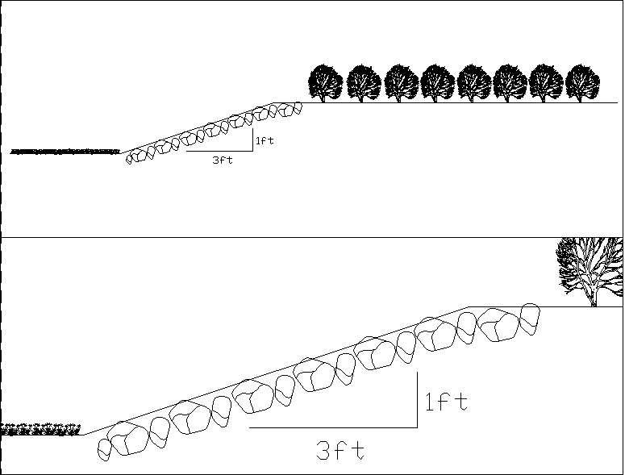
See Detail Below
Manning’s Coefficients:
Upstream – 0.15, all willows
Slope – 0.07, all boulders
Downstream – 0.09, all grass
Source: AutoCAD Civil 3D

Slide 19
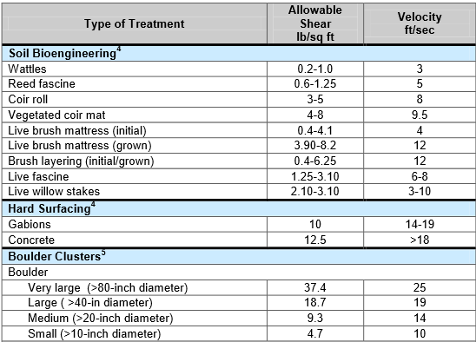
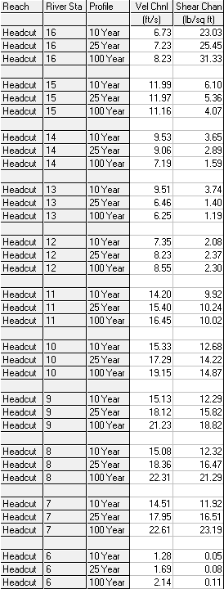
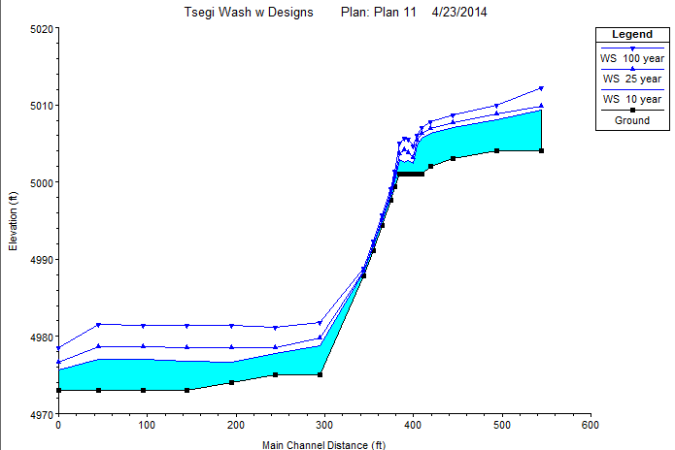
Source: NRCS
Source: HEC-RAS Software

Slide 20
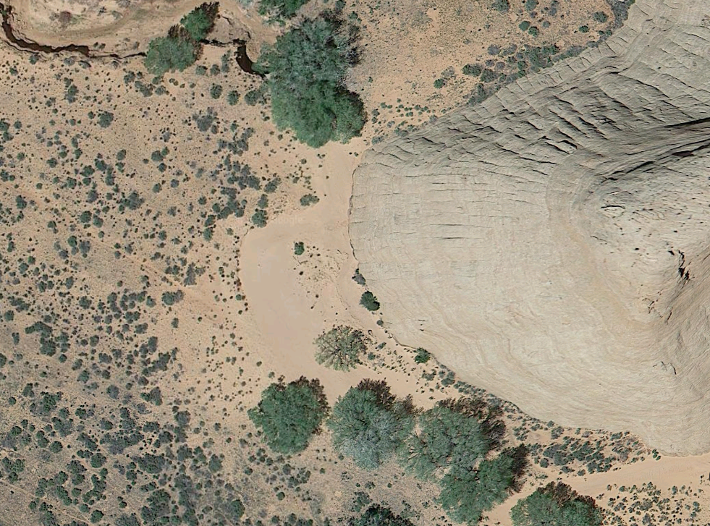
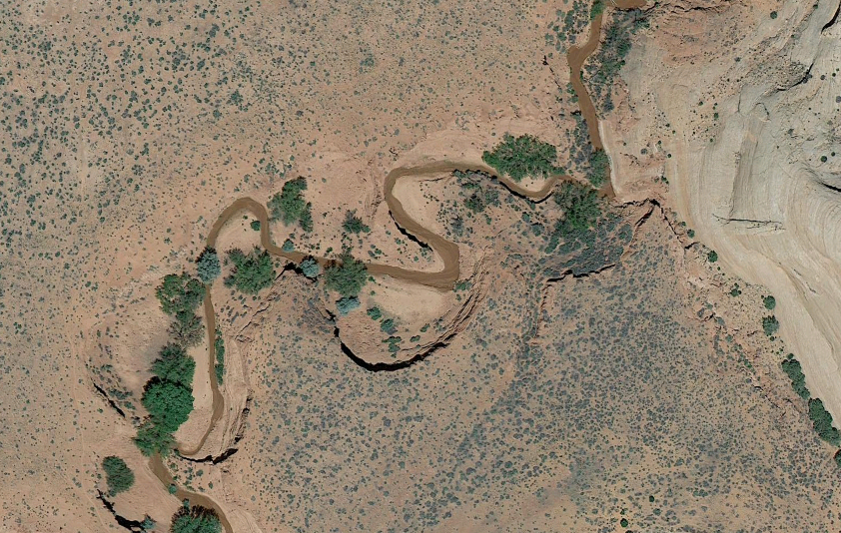
Do Nothing
The do nothing alternative leaves the headcut in its current conditions.
Potential Oxbow Above Headcut
Completed Oxbow in Neighboring Canyon
N
N
Source: Google Maps

Slide 21
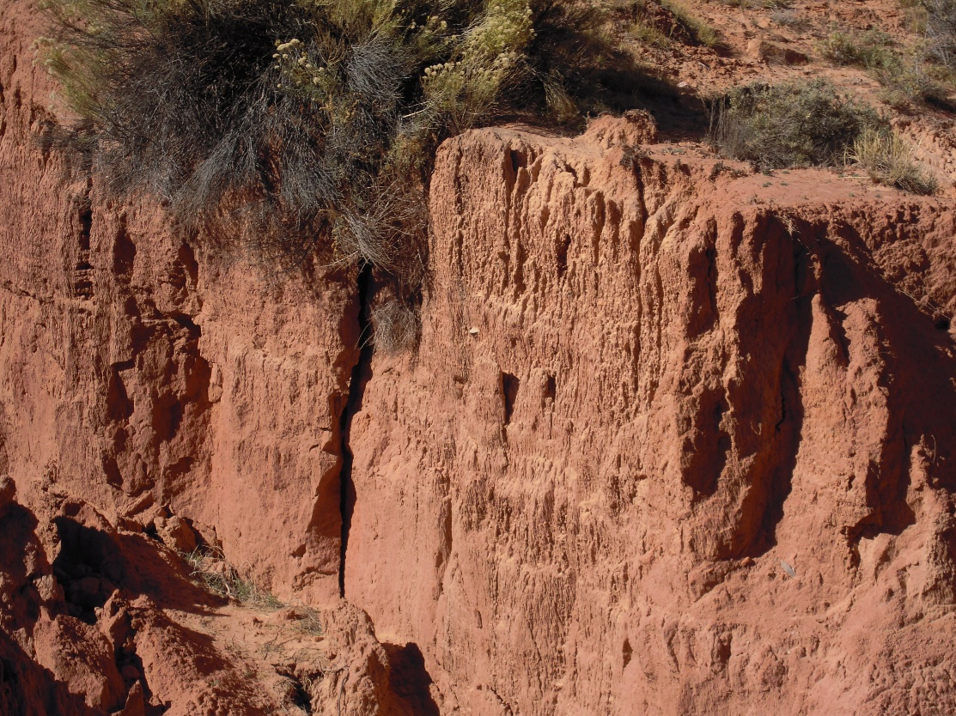
Impacts Evaluation
Economic Impacts – Evaluation of the design cost and feasibility for the client
Cultural Impacts – Evaluation of design to assure no cultural artifacts and/or spiritual beliefs of the Navajo nation are at risk
Ecological Impacts – Evaluation of the effect of the solar pump on the water table

Slide 22
Impacts Comparison
Hard Armoring
High cost
Possible disturbance of artifacts and ancestral remains
Water table drawdown due to solar pump
Possibility of stabilization bypass
Do Nothing
No cost
Continuation of artifacts washing into Lake Powell
Continuation of sediment deposition into Lake Powell
Headcut may continue to erode until self-stabilization

Slide 23
Cost of Design
Task | Senior Engineer | Engineer | EIT | Tech | Admin. Asst. | Total Hours | Total Cost of Task
Fieldwork | 24 | 24 | 24 |  |  | 72 | $1,901
Hydrology |  | 20 | 20 |  |  | 40 | $4,048
Hydraulics | 15 | 20 | 20 | 20 |  | 75 | $4,048
Armoring Design | 40 | 30 | 20 | 20 |  | 110 | $11,867
Impacts Evaluation | 8 | 8 |  |  |  | 16 | $2,187
Document | 20 | 20 | 15 |  | 30 | 85 | $5,759
Total | 107 | 122 | 99 | 40 | 30 | 398 | $29,813

Slide 24
Cost of Implementation
Cost of Each Alternative
Detailed Cost of Hard Armoring
 | Live Vegetation | Bioengineering | Hard Armor
Materials | $20,219 | $61,478 | $45,982
Equipment | $15,830 | $16,017 | $27,197
Labor | $6,400 | $6,400 | $6,400
Design | $29,813 | $29,813 | $29,813
Total | $72,262 | $129,538 | $109,392
Materials | Willows | $450
 | Rocks | $26,400
 | Seeds | $132
 | Solar Pump | $19,000
Equipment | Backhoe | $2,800
 | Bulldozer | $11,480
 | Helicopter | $12,917
Labor | 4 People | $6,400

Slide 25


Acknowledgements
Client: Renee Benally, BIA,
Western Navajo Agency
Technical Advisor: Mark Lamer, P.E.

Slide 26
References
http://www.iowadot.gov/research/reports/Year/2008/fullreports TR-541%20Final%20-%20T.%20Papanicolaou.pdf
http://www.omafra.gov.on.ca/english/engineer/facts/13-035f5.jpg
http://www.nrcs.usda.gov/Internet/FSE_DOCUMENTS/nrcs142p2_024130.pdf
http://www.lowes.com/cd_Seed+Calculator_54331289_
http://www.nrcs.usda.gov/Internet/FSE_DOCUMENTS/nrcs142p2_024130.pdf
http://www.epa.gov/owow/nps/unpavedroads/ch5.pdf
http://www.conteches.com/products/erosion-control/temporary-and-permanent/turf-reinforcement-mats.aspx

Slide 27

Questions?

